Slide 1
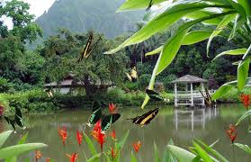
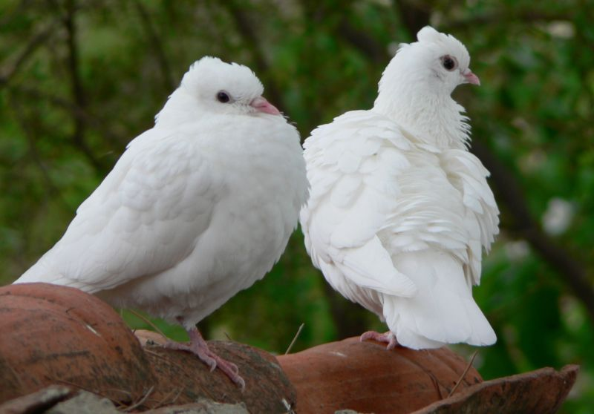
Happy morning my dear students.
Welcome to Digital Class.

Slide 2
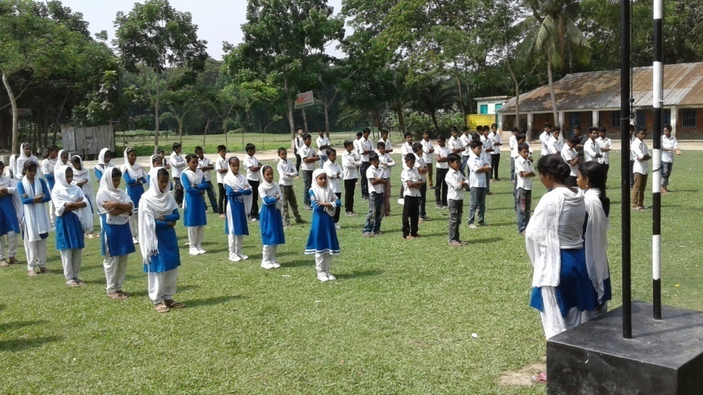
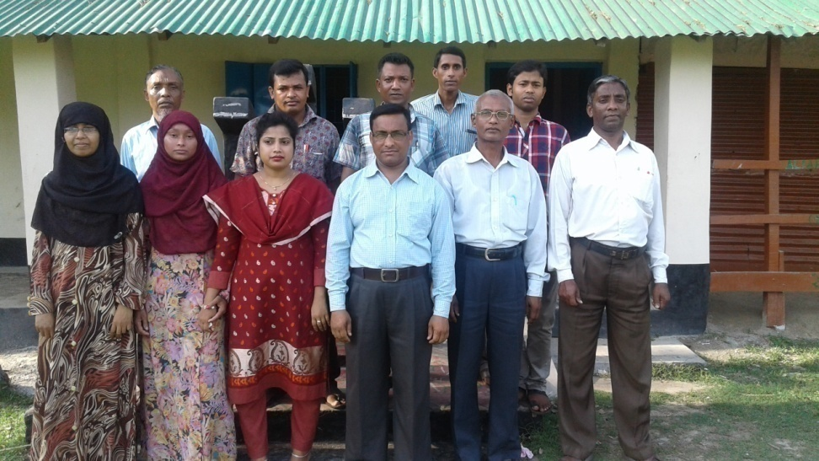
SCHOOL IDENTITY

Slide 3
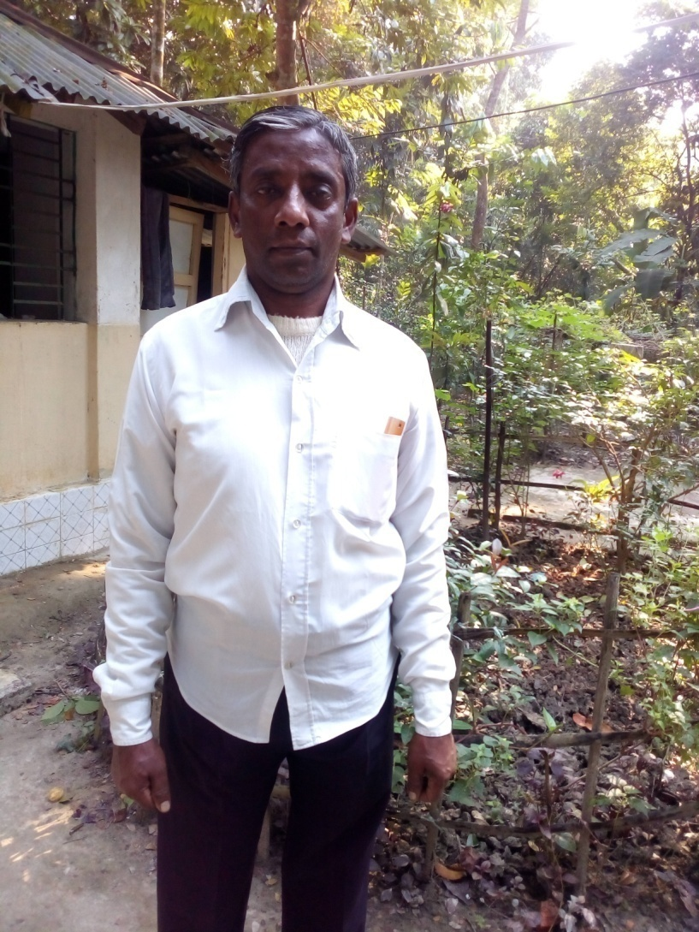
TEACHER IDENTITY
Shanti Ranjan Chakraborty
Assistant Teacher,
Shanuher M A High School,Ujirpur,Barisal.Mobile-01715485221
shanti02266@gmail.com

Slide 4
My dear students, do you know about a thanks letter?
Let us see .

Slide 5
Lesson declaration
A thanks letter.
From informal letter part
English First paper
Class IX & X

Slide 6
17 Feb, 2017.
Barisal.
Dear Salma,
At first take my cordial love. I hope you are well by the grace of God.

Slide 7
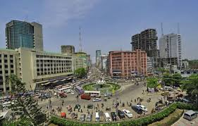
Dhaka
I reached home safely/ safe and sound.
But I cannot forget the memory of last 7 days with you.
7 Days

Slide 8

I could not think of your so warm reception.

Slide 9
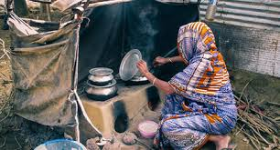
Specially your mother’s entertainment.

Slide 10
She was almost restless to entertain me with different kinds of interesting foods like-

Slide 11
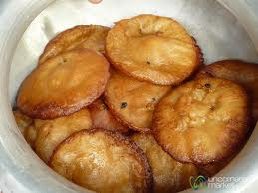
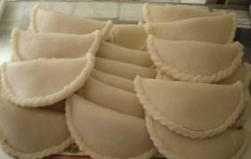
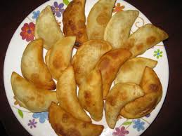
kuli pitha
Pan pitha
bhapa puli

Slide 12
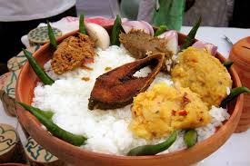
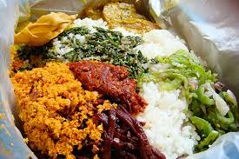
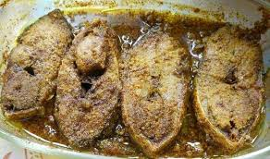
pantha ilish with matched potato.
vegetable curry
fried hilsha

Slide 13
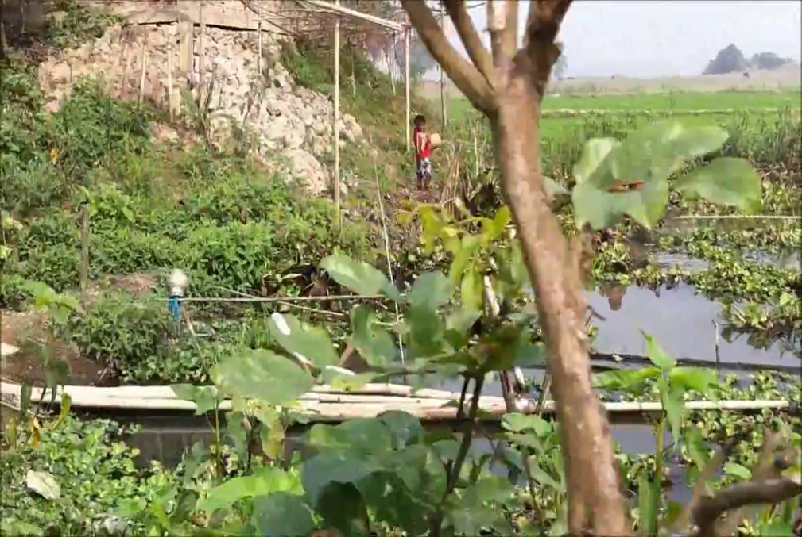
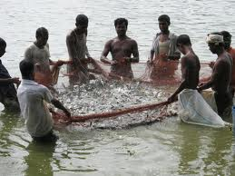
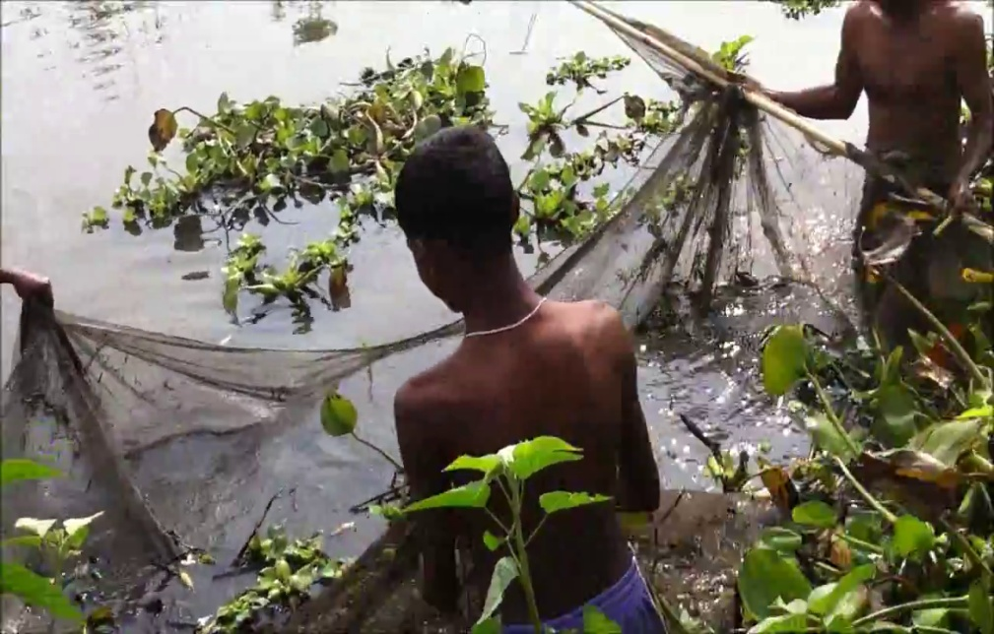
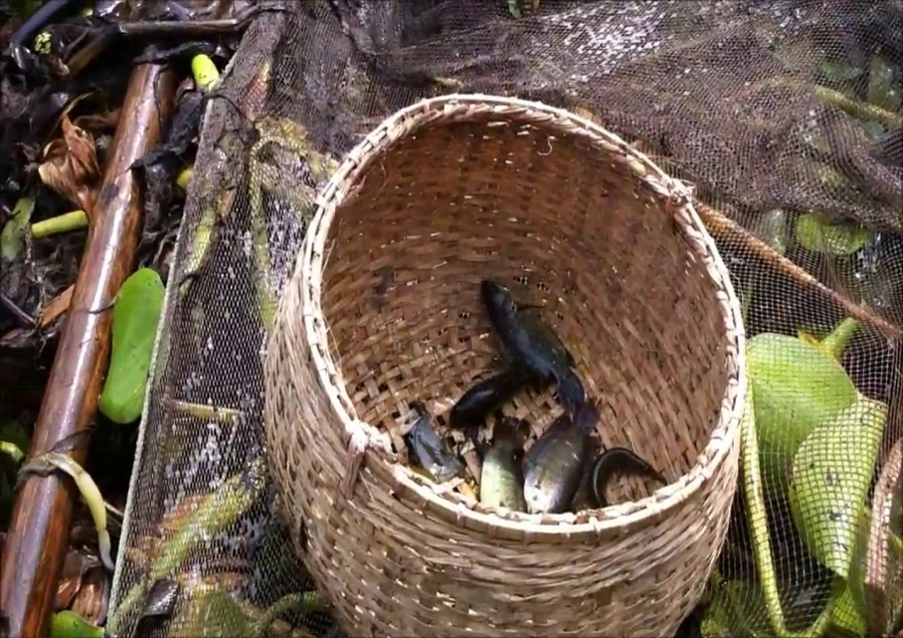
I enjoyed catching fishes in the swamp,

Slide 14
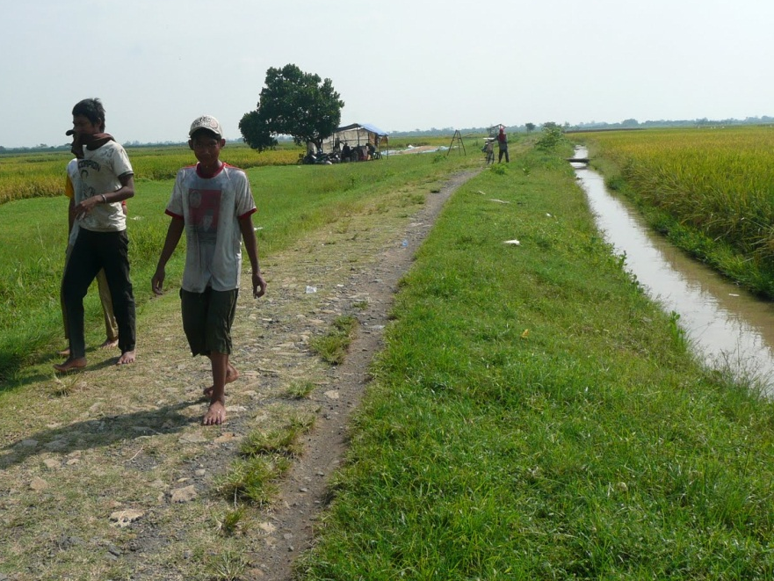
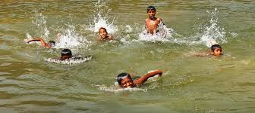
walking by the green fields
swimming in the pond

Slide 15
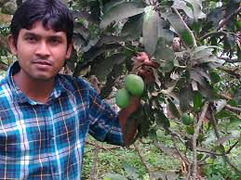
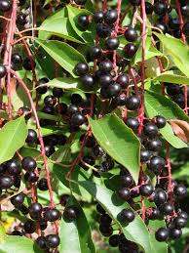
I also enjoyed picking mangoes from
the tree and tasted it in the orchard.
How beautiful the black berry to taste!

Slide 16
Actually I was very excited with you and all.
I will never forget you, your mother, your brothers and all the members of your house as well as the fresh food and fruits.

Slide 17
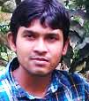
I am really grateful to you . So , thank you very much for your cordial hospitality. Please write to me soon.
No more today. More when we met again. With best regards to you all.
Yours ever,
Soumen.

Slide 18
Group Work

Slide 19
Evaluation
Suppose, you are Soumen, a student of Cambrian School & College. You stay in Cambrian hostel, Dhaka. You have a friend Toukir by name,who lives in Bagerhat. You went to your friend’s village to spend a summer vacation. There you were received warmly. You were entertained with different interesting food and fruits and you enjoyed many interesting things. You came back to your hostel safe and sound.
Now write a letter to your friend thanking him for his hospitality.

Slide 20
Home work
Suppose, you are Soumen, a student of Cambrian School & College. You stay in Cambrian hostel, Dhaka. You went to your village home to spend summer vacation.
Now write a letter to your friend, Suman Who lives in 123/A, K Ali road, khulna, about how you spent the summer vacation.

Slide 21

Thank you so much.

